Slide 1
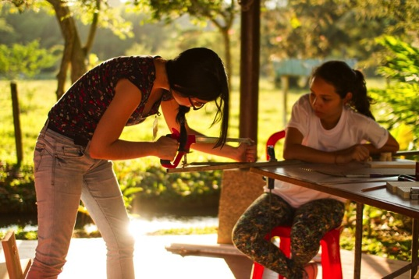
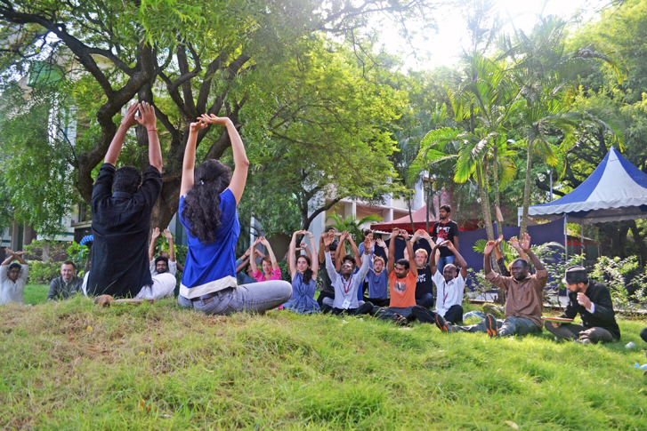
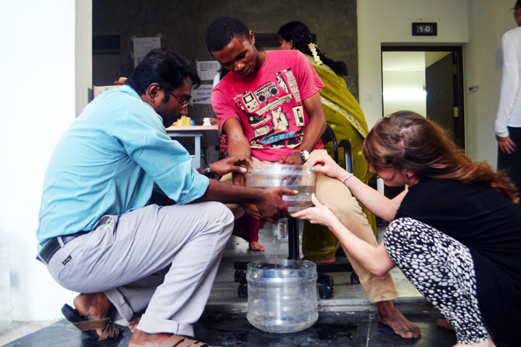
Learning from our Elders:
IDDS Lessons Learned

Slide 2
IDDS will be a success if…
Notes:
At the beginning of every summit we ask organizers and participants “IDDS will be a success if…”
Everybody’s answer is different; some on participants, some on producing projects, on rel with local community, etc.
At end of day it’s about a balance for participant, communities, projects, and you as organizers.
Hopes and dreams for participants, organizers, projects, communities
Lessons on how to reach this success

Slide 3
We’ve been collecting lessons from…
Participant Surveys: Pre, Mid, and Post
Organizer Surveys: Pre and Post
Organizer Debriefs
Project Documentation
Observation
Informal Feedback
Data Collection Process
Communities
Projects & Teams
Curriculum & Content
Organizing Team & Prep
Takeaways
Background
Notes:
Pick one lesson

Slide 4
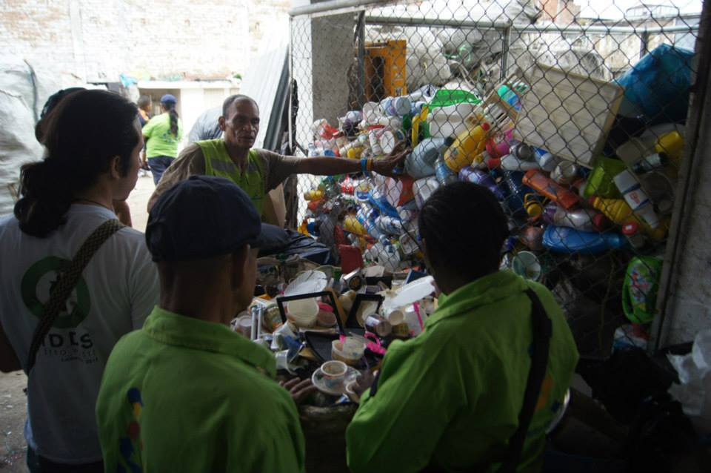
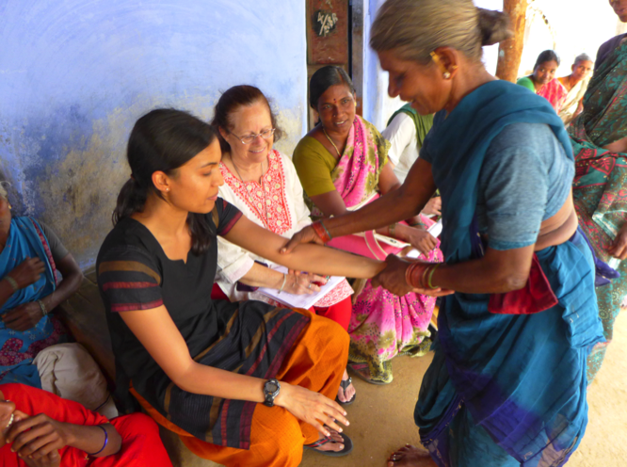
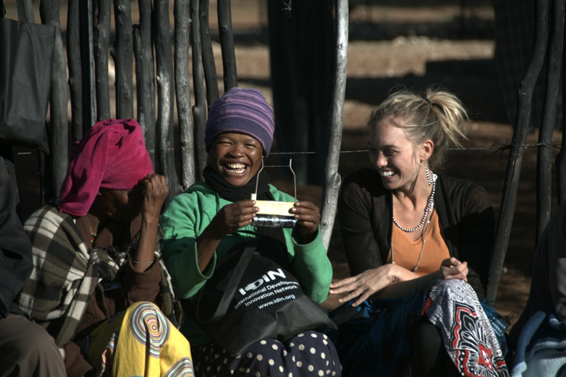
Communities
Effective community engagement can take different forms…
…but without at least one of these, IDDS loses something fundamental.
Community members and leaders as participants
Involvement of local government and universities
Repeated, extended community visits
Hosting summits in communities
Data Collection Process
Communities
Projects & Teams
Curriculum & Content
Organizing Team & Prep
Takeaways
Background
Notes:
The model will affect the main takeaways.
*Cali - inclusion of 15 participants who are part of waste-picker associations meant a greater connection to the community – important to note that these participants were generally leaders within their own communities, making them more likely to be leaders within their teams at IDDS.
*D’kar was very different in terms of who the local participants were – some were clearly leaders, but others were less so. Also, the fact that it was IN the community meant that community members were able to participate who might not have otherwise. Many had to leave and do other things at various times throughout the summit, which may have slowed some teams down, but being understanding and tolerant of this probably made the summit more inclusive.
Two-week summits in general might attract people who would be unable to participate in a full four-week summit…
Stronger community relationships mean stronger possibilities for continuity.
Amy: whenever possible, have community members active full-time participants – better for their own experience and continuity
Pedro: Working closely on project selection with communities is great not only for community experience at the summit but for making sure the community can take ownership of them after the summit.

Slide 5
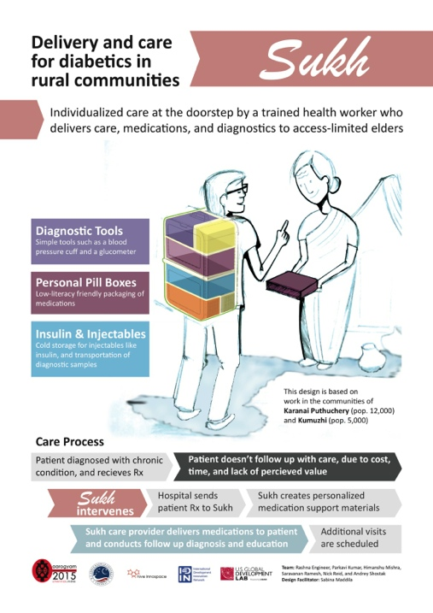
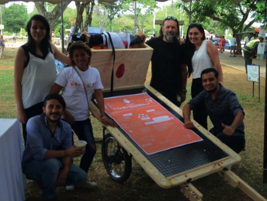
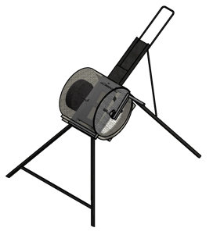
Projects & Teams
Good project selection is critical…and difficult.
  Especially important to plan ahead for short summit
  Bottom line: ownership from the community is the key to problem framing
Take the time to form teams thoughtfully, balancing out skill sets
Plan for continuity from Day 1 of planning, and communicate this plan to organizers, participants, and community members
Sukh Diabetes Care
IDDS Aarogyam
Rex-cicleitor
IDDS Zero Waste
Fodder Chopper
IDDS D’Kar
Data Collection Process
Communities
Projects & Teams
Curriculum & Content
Organizing Team & Prep
Takeaways
Background
Notes:
Why does this matter? Project really frames experience for participants. And a well-framed problem helps create change and impact.
Sher: It’s ok for projects to pivot. And it’s ok if some projects do not continue. It can be a measure of success, but it’s not the only one. Projects are a vehicle for learning about co-creation – participants might discover some project not good to continue because community does not want it/need it, or bad design and needs reiteration. That’s ok and part of the learning process.
Amy: Good project selection difficult with large group of people. Have a small group that takes leadership of the scoping and framing of the summit.
Mustafa: We had a committee, some were outside Lahore. One of the challenges – not a lot of us had done it before and another challenge was we did not have our sectors narrowed down. We started with 6 sectors and had to narrow down on each. We had to meet mulitple stakeholders in each of those sectors to get to know them them better. Lots of meetings, lots of people. Easier to do it with just one sector, esp when local bandwidth and time is limited.
Laura: Most of this does have to happen at the local level – remember that when assigning roles and it will fall on your local team.
Pedro: Important to be prepared to change projects right on the spot. In Colombia last year we sent out before hand, but at the summit some people wanted to move and some projects orphaned – so ok to re assess at the summit as well. Be ready to be flexible and trouble shoot on the spot. Having a few back-up projects ready helps.
Mustafa: Good to have narrowly defined problem framings. The weaker the problem framing the harder it becomes for the team.. What ends up happening is those starting with better framing end up getting way ahead and the others get discouraged and fall behind. So its good for framings to be equal and narrow –esp for a two week summit. All of them should be narrower than what they normally are.
Laura: Great ex is Avocado project in TZ 2014. That project could have been broadly defined (Increase income for farmers in this village). Could have been super narrow (build a machine to extract avocado oil) –not much creative space, you’ve already given them a solution. Then there is space in between (opportunity to make more income, there’s a lot of avocados) – then narrows it, but still gives them room to be creative.
What’s key to have them all be same degree of narrow.
Amy: For some summits you might want them to focus on problem framing, but you have to save time for that in your curriculum (and know that means less time prototyping).

Slide 6
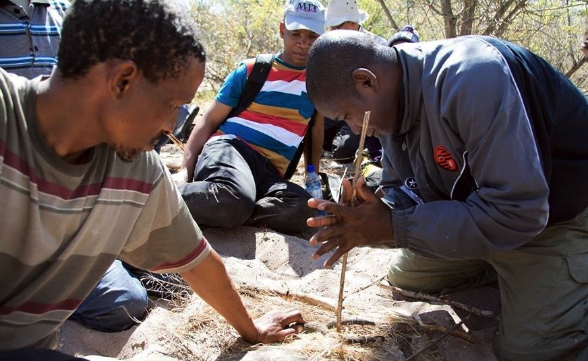
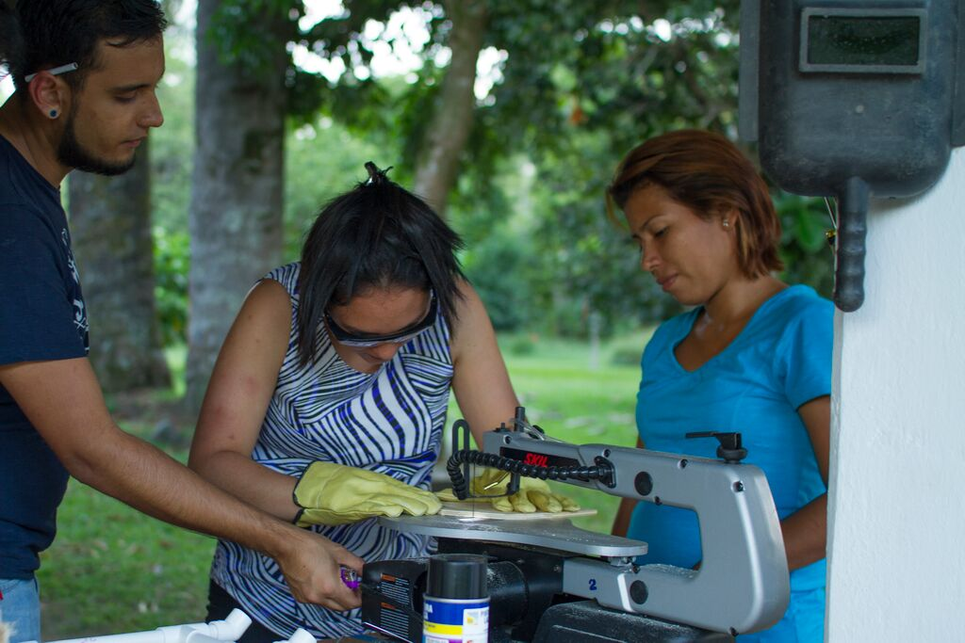
Curriculum & Content
Adapt the content to the context
Embrace the expertise in the room
Escape the monotony - Diversify the delivery
Build in business models from the beginning
Don’t try to do too much!
Data Collection Process
Communities
Projects & Teams
Curriculum & Content
Organizing Team & Prep
Takeaways
Background
Notes:
Skill builders are a good example. In Zero Waste skill builders (formerly called build its) all used recycle materials or machines to use recycled materials. In D’Kar – skill builders were all from from locals (like fire starting). From IDDS Lahore (ICT themed) all were ICT skill builders. Adapt to your summit.
Embrace expertise in the room: no one is an empty vessel. All are bringing something excellent. The more you take advantage of the expertise the better. Ex. San community local artisans teaching us their crafts. IDDS Zero Waste had a panel where participants showcased their work and talked about waste and their examples. Have been times in some past summits where ppl who know design were not being asked to help teach and felt talked down to. Engage your participants at their expertise.
Business should not be an afterthought, but something integrated from beginning and throughout (and there needs to be time for it in the curriculum – you will have to cut some things out or decide what not to do regarding business).
Amy: If people been sitting all day, don’t keep them sitting down. If they’ve been working all morning, don’t keep them all their feet in the afternoon. People appreciate the variety of learning methods IDDS has to offer. IF you’re in the classroom – how can you make it more active and inter-active? How can they be engaged? And make it vary session to session.
Debora – Yunas interested in doing 2-3 days business for summit. What do you guys think?
Laura: we tried to add bus bootcamp at end of summits and didn't’t go well. Felt separate – prob because guests from outside and weren’t aware of what IDDS is or has done already. Can feel disjoined and separated if new guests haven’t been there. Find a way to integrate as much as you can from beginning.
Amy: Sometimes we have guests come in a bit earlier so it can be a seamless integration – staying for the whole time if possible.
Pedro: At IDDS Educacion we’re telling participants a bit about business, but mainly going to use it as one of the options for continuity after the summit.

Slide 7
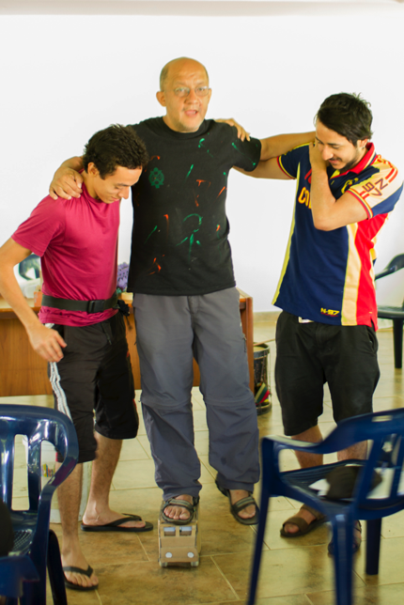
Organizing Team & Pre-Summit Prep
Be clear, honest, and realistic about organizers’ roles. Then fill them wisely.
Support organizers with buddies and an on-site orientation.
The lead organizer and lead instructor set the tone.
Limit disruptive guest parachuting.
Data Collection Process
Communities
Projects & Teams
Curriculum & Content
Organizing Team & Prep
Takeaways
Background
Notes:
Note that its super important to have more local organizers – makes it so much easier and also more relevant to them.
Create a mechanism so organizers feel supported and not alone in their roles.
If you’re going to have guests coming in – integrate them as best you can. Guests coming in and out can be very disruptive.
Pedro: We’ve been doing a lot of different things with organizing team bc we are a big team and didn’t know each other and wanted to bulid connection. We do digital morning circles sometimes, ppl talking abou their own projects what they’re doing, we do games (sometimes people take pictures of what ppl have in their desk), I take pictures of a proverb and every day send a proverb to organizers, just something to build community. Have formal meetings, but also have time to talk about what their interests are, what moves them, and bulid community.
I meet time to time one on one with organizers to see what they are doing, what I can learn about them, etc. So that I know what people are like and we know we can lean on each other. We also have a What’sApp group.
Sher: Debbie suggested using some of the IDDS co-creation tools with your team leading up to the summit to get to know each other. (ex. working style worksheets, team charter, knowing what to do if you disagree).
If you’re not sure what your role is – ask your team, ask your lead organizer – they’d be happy to let you know.

Slide 9
The IDDS Theory: People
If we
Bring together a diverse group of people
Equip them with design skills
Immerse them in multi-cultural teams & a new culture
Provide an atmosphere of respect & empathy
…then they will have a transformative experience,
inspiring and empowering them to…
Bring co-creation & innovation back to their communities
Become engaged members of the network
Become innovators & entrepreneurs
Notes:
These were not in the organizer hangout – but fun info to read about…

Slide 10
The IDDS Theory: Projects
If we…
Identify a design challenge that is IDDS-appropriate and represents a real need in the community
Form a team with a good mix of strengths
Facilitate the team’s design and co-creation process in the community
Link the team with IDIN partners and resources
…then they will produce a valuable prototype that will continue to develop after IDDS.

Slide 11
The IDDS Theory: Communities
If we…
Engage communities in a meaningful way before and during the summit
Tackle problems that represent real needs and foster local ownership of those projects
Put in plan a place for continued engagement after the summit
…then communities will get more value out of the summit, participants’ experience will be enhanced, and the projects will have higher potential for impact.

